Slide 1

Red Wine Quality
ANNIE ZHANG, FILY CHAN, JOELLE LEUNG, ROBERT WANG
Notes:
Good evening everyone,
My name is Fily and my group mates:
Annie, Joelle and Robert
We chose to look into the Red Wine dataset

Slide 2
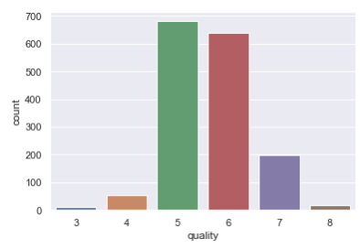
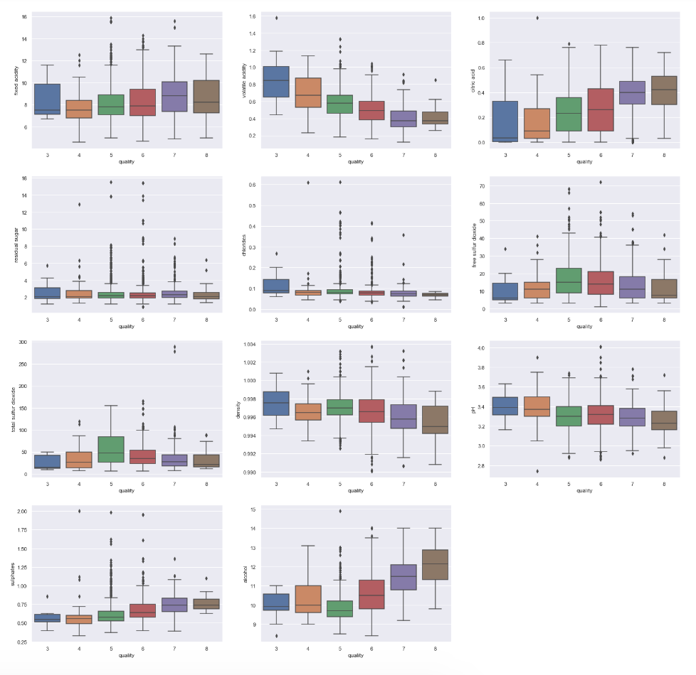
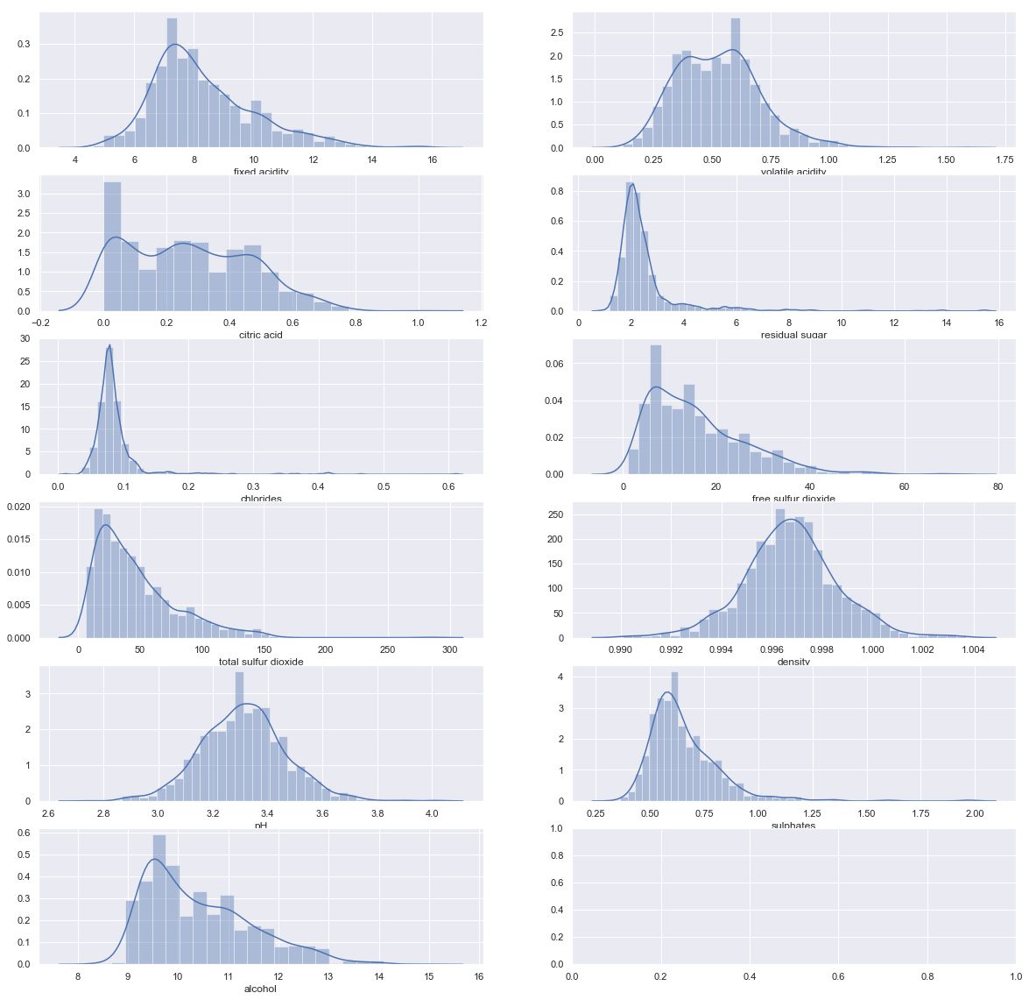
Data Exploration
Wine Quality
Box Plots
Quality
Fixed Acidity
Volatile Acidity
Citric Acid
Residual Sugar
Distributions
Chlorides
Free Sulfur Dioxide
Total Sulfur Dioxide
Density
pH
Sulphates
Alcohol
Notes:
with this dataset we want to predict the score given to red wine which is the quality.
This data set has 1599 entries of red wines
There are 11 features to the quality of red wines.
When taste testing wines, sommeliers give the quality of wine a score between 0 (lowest) and 10 (highest).
Quality count - quality of red wine are mostly scored between 5 and 6
It is important to note we see some features are skewed
for example critic acid is left skewed and trimodal
other data is very left skewed, therefore we expect there to be outliers to remove
7. using the box plots on the right we can see the outliers more clearly

Slide 3
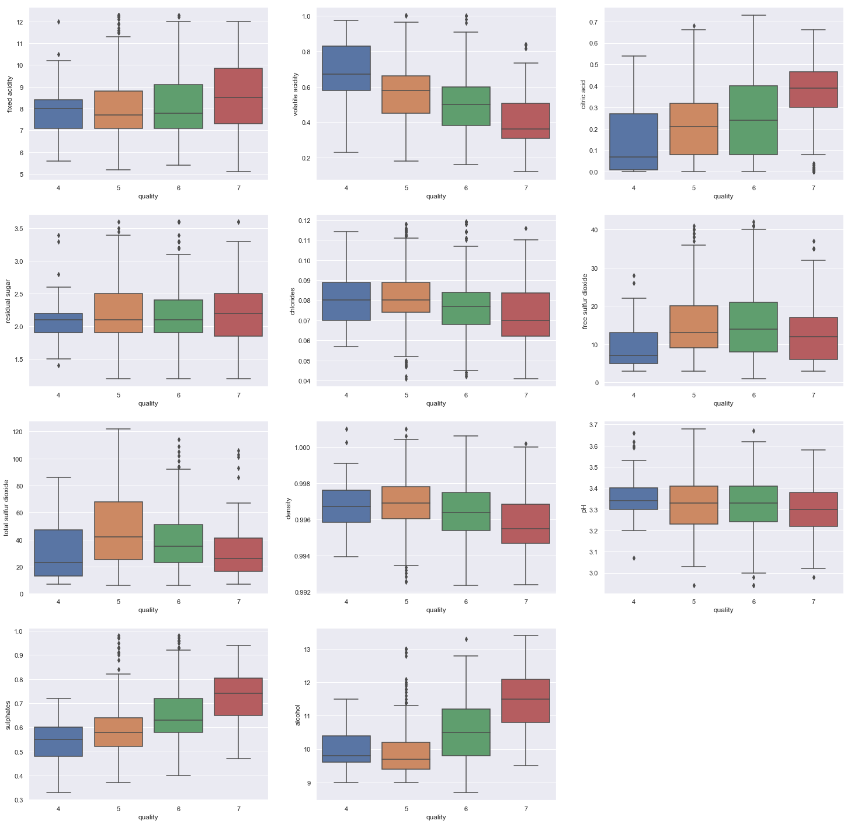
Data Preparation
Removed outliers using Interquartile Range (IQR)
Focus on Score 4 - 7
Notes:
Next we did data preparation
using IQR, we removed the outliers that were beyond the whiskers
we did this by focusing on wines that had a score of 4 to 7 as that is where the majority of our wine quality lies and will help us build a more accurate model

Slide 4
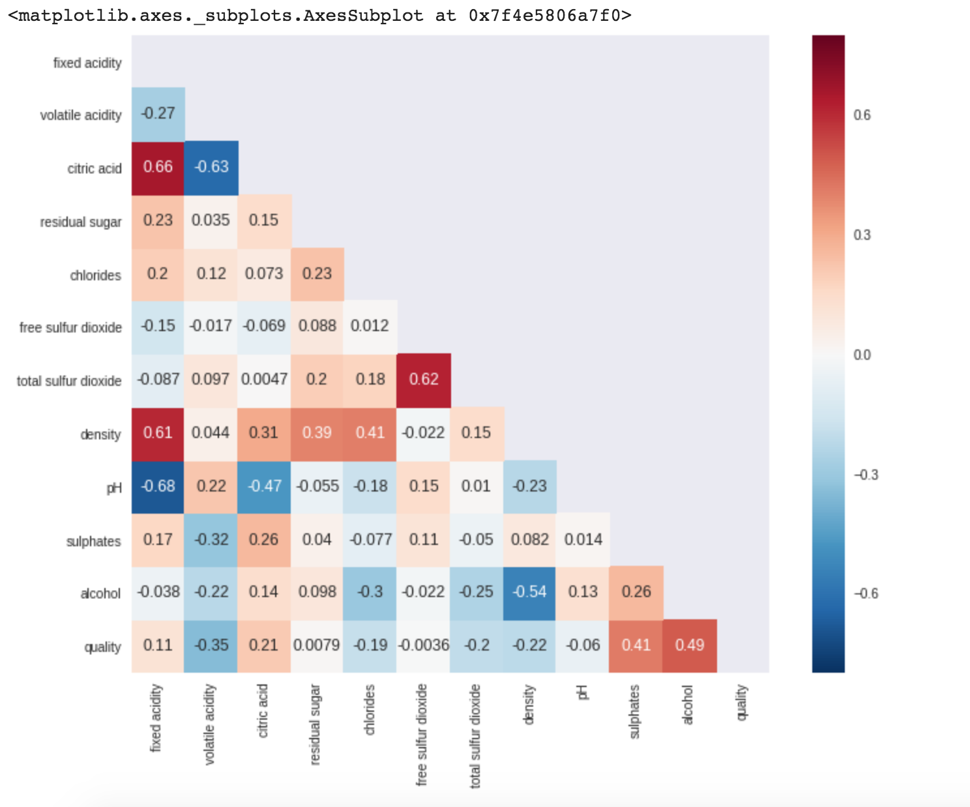
Correlation Analysis
Matrix
Observations
Multicollinearity
Positive: Moderate between quality and alcohol
Positive: Very high between citric acid and fixed acidity at 0.66
Positive: Very high between total sulphur dioxide and free sulphur dioxide at 0.62
Negative: Very high between pH and fixed acidity at -0.68
Notes:
Next we did a correlation analysis
we found features that correlated with our target variable (quality): alcohol, volatile acidity and sulphates
It is also important to note the following observations
There appears to be multicolinnarity from our data.
For example
Positive: Moderate between quality and alcohol
Positive: Very high between citric acid and fixed acidity at 0.66
Positive: Very high between total sulphur dioxide and free sulphur dioxide at 0.62
Negative: Very high between pH and fixed acidity at -0.68

Slide 5
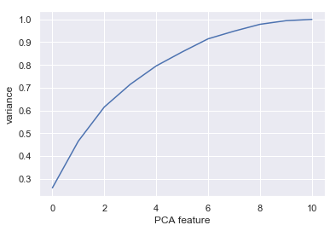
Dimension Reduction and Logistic Regression
7 Components for predictions
95% of variance
Using Logistic Regression as benchmark:
Accuracy Score: 65.25%
Notes:
We resolved Multicollinearity by combining the highly correlated variables through principal component analysis.
Using PCA, we picked 7 components for predictions as it attribute for 95% of variance .
Here we can see, by simply using Logistic regression, the accuracy of the prediction is helpful for detecting the quality of the wine. So here we will start to apply more complex models

Slide 6
Random Forest
KNN Classifier
0.5915 {'n_estimators': 4}
0.6012 {'n_estimators': 5}
0.6351 {'n_estimators': 10}
0.6484 {'n_estimators': 20}
0.6654 {'n_estimators': 50}
0.5503 {'n_neighbors': 3}
0.5745 {'n_neighbors': 5}
0.5709 {'n_neighbors': 10}
0.5624 {'n_neighbors': 20}
Best Option:
Random Forest with n_estimators = 50
Notes:
Next we did, Random Forest and KNN Classifier .
We can see that Random Forest with n_estimators = 50 is the best option using grid search best parameters.
Using Knn best parameters, n_neighbors = 5 gave the best result
Overall, Random Forest with n_estimators = 50 gave better results of the two.

Slide 7
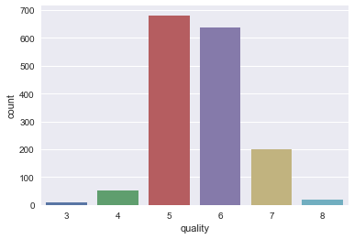
Binary Decision
Test Data Score = 63.28%
Good: quality >= 6,
Bad: quality <=5
New score = 74.29%
Notes:
Therefore continuing on using Random Forest Classifier, all the predicted value for quality are scored 5 or 6.
Comparing to the raw data, we confirm that 5 and 6 dominate the dataset.
So in this case, we can transform the model into a binary decision: Good: quality >= 6 as 1 , Bad: quality <=5 as 0
Next, Robert will talk about the performance of the model.

Slide 8
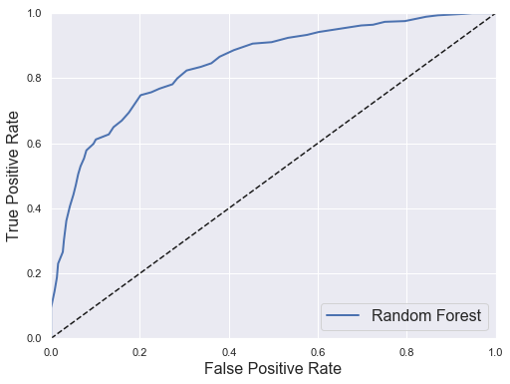
Re-Apply Random Forest

Slide 9
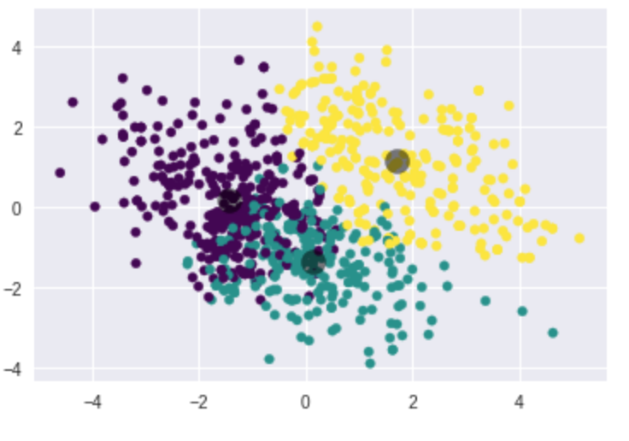
Cluster Analysis - KMeans
Separated the data into three groups using K-means
However, many data points are overlapping with each other

Slide 10
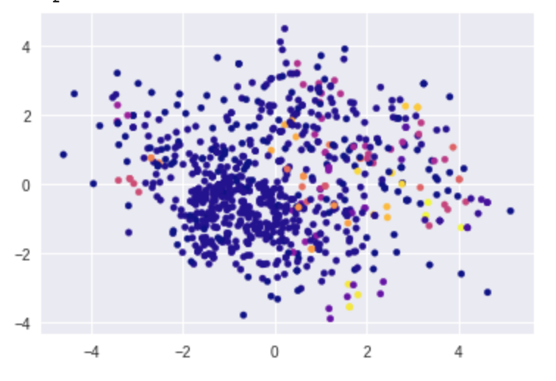
DBSCAN Clustering
Data are not too far from each other
All the outliers did not form into a new group

Slide 11
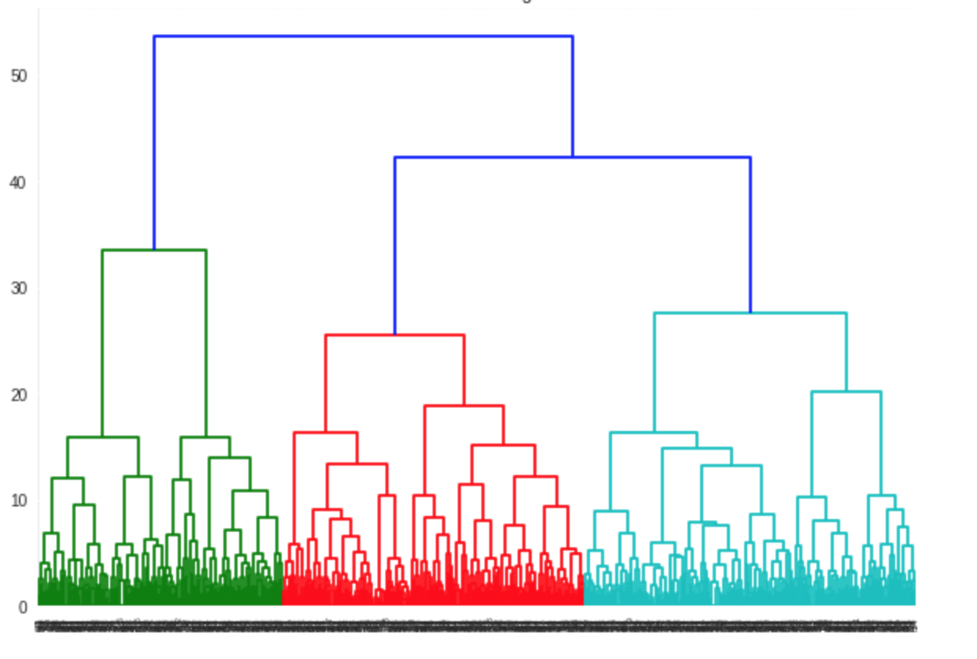
Hierarchical Clustering
Trivially separate into 3 groups
Subset the data into 4 different groups based on the index of the data.

